Slide 1



Electronic Propellant Feed System
Johnny Froehlich, Jonathan Talik, James Luce, Rawand Rasheed, Mimi Shang, Jordan Roland
Affiliations: ¹Portland State Aerospace Society, ²Maseeh College of Engineering and Computer Science Portland, OR, 97201, United States

Slide 2
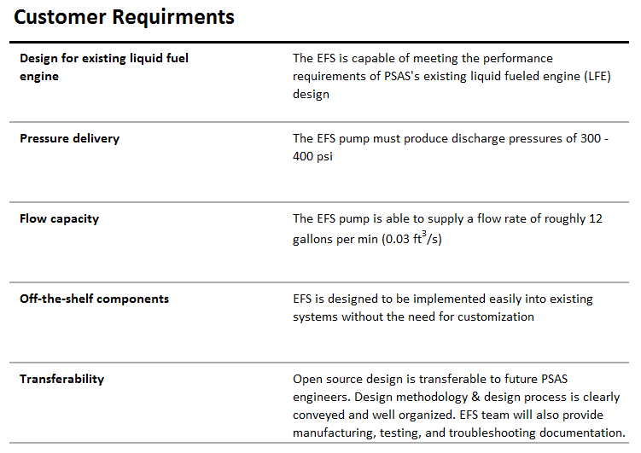
Portland State Aerospace Society | Electric Propellant Feed System

Slide 3
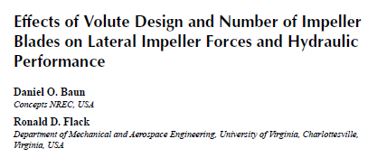

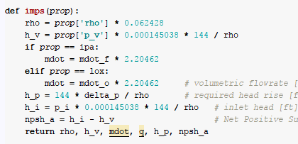





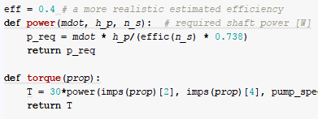






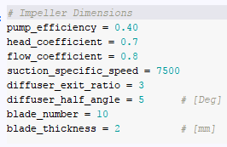



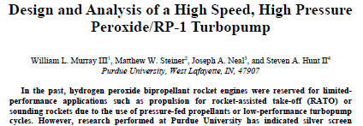


Open-ended literature review
Puzzle break
Scientific computing
We make some guesses too

Slide 4
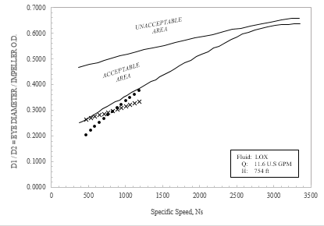
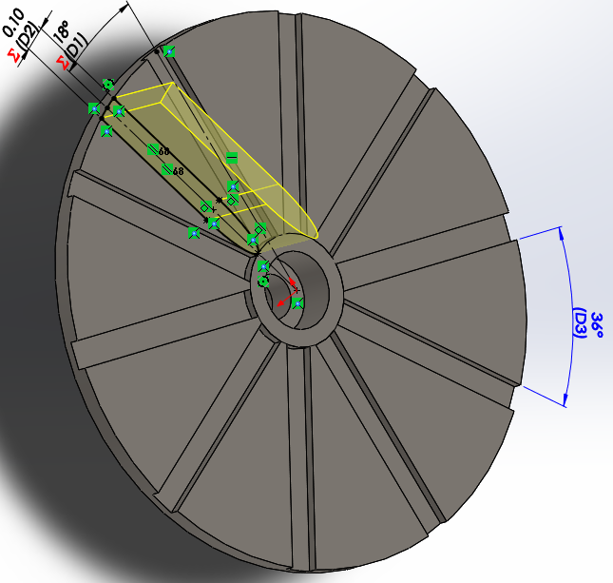
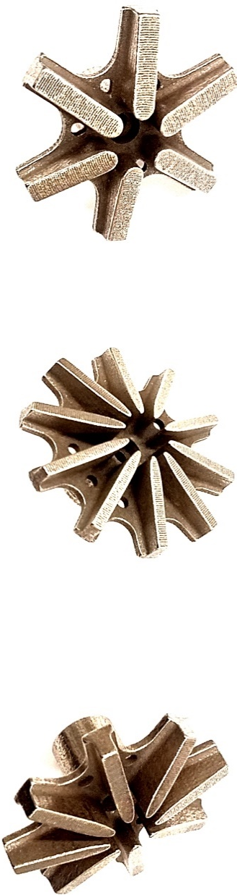
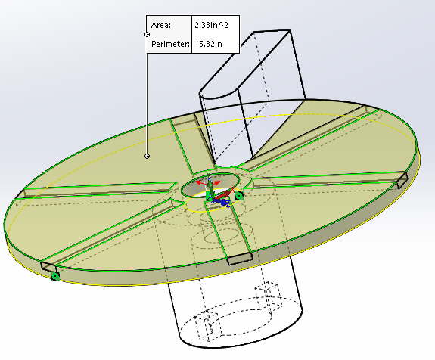
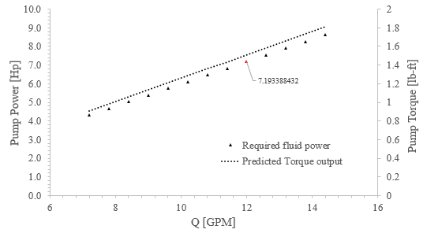
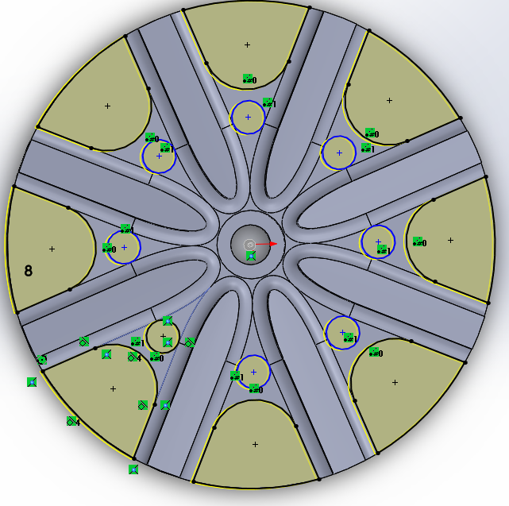
Map out predictions
Play with the design
You are here

Slide 5
Portland State Aerospace Society | Electric Propellant Feed System

